Slide 1

CATCH ’24- Hackathon
(Round-3)
T
Problem Statement: Create a game using JS
College Name: Mahendra engineering college
Team Name: TECH GENIUS
Team Leader Name: D.SURIYA

Slide 2
CREATE A GAME USING JAVASCRIPT
JAVASCRIPT is also an ideal language to begin your adventure with creating games.
The JAVASCRIPT libraries makes creating a 2D Game in JAVASCRIPT.
JAVASCRIPT provides enough performance for most Game development requirements.
JAVASCRIPT is sufficient for games with basic Graphics,Gameplay and AI requirements.
JAVASCRIPT is a versatile and widely used programming language.

Slide 3
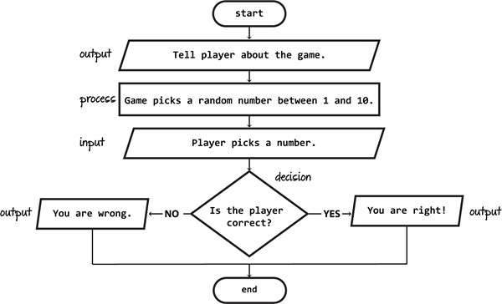

Slide 4

idea /solution
it makes us entertain and stress free.
Our app is designed only for android.
Hand cricket is a game in which two play compete against each other using their fingers.
In each turn, Both players display a number using their HAND at the same time.
If the FINGERS match, the batsman is out. otherwise they gain their number as runs.
Finally ,the player who scores the most wins the game.

Slide 5
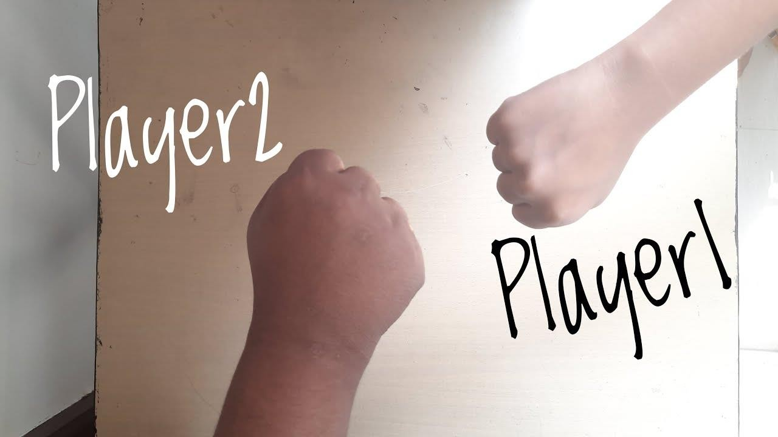


Slide 6
Tech Stack
HTML: To structure the game’s interference and layout CSS: To style the visual elements of our game for engaging user experience JAVASCRIPT: To utilize user interaction and dynamic content generation. To write the game including rules, scores, player turn and result. Browser Testing: Testing across various web browsers to ensure compatibility and performance.
Dependencies / Stopper
Rules: Establish clear rules for how the game will be played. This includes determining how runs will be scored, how wickets will be taken, and what constitutes a legal delivery.
Scoring System: Decide on a scoring system for runs scored off each delivery. This could involve assigning numbers to different hand gestures or using a predetermined system like odds and evens.

Slide 7
Use Cases
Indoor Activity: When outdoor activities are limited due to bad weather, hand cricket offers an indoor alternative that keeps everyone entertained without the need for any special equipment.
Travel Entertainment: Hand cricket is an excellent way to pass the time during long journeys, whether on a road trip, train ride, or airplane flight. It requires minimal space and no equipment, making it ideal for cramped quarters.
Playing with closed ones: You can play with your closer ones even when they are far away from you.

Slide 8
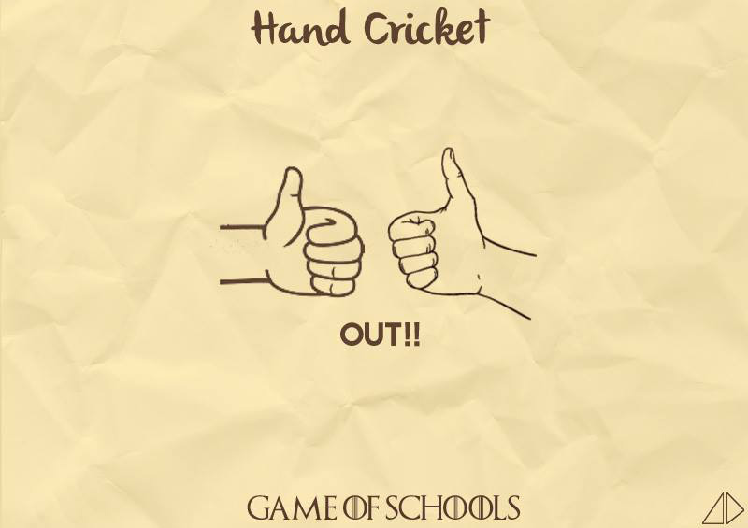
Thank You

